Slide 1



NEWS SUMMARY BY MACHINE LEARNING APPROACH
Team member:
Nguyễn Trí Chấn Hưng 1552159
Lê Bá Thành 1552340

Slide 2
CONTENTS
Introduction
Process Datasets
Algorithms
Our Work
Demonstration
- Conclusion

Slide 3
INTRODUCTION
1. What is news summary?

Slide 4

INTRODUCTION
News articles can be long and often take too much time to get to the point. Because of this, writers may want to summarize a news article to uncover the objective faster.
A summary offers readers a chance to understand the main idea of the piece, without needing to read the actual text itself. It helps present the reader with the main points in a shorter amount of time, by excluding details that aren't necessary. You can summarize any piece of writing,

Slide 5

INTRODUCTION
2. The Goal Of Summarizing a News Article
The main purpose is to take all the information and take it shorter.
Get the main idea of the news and ignore the unnecessary information in the article.
Helping the saving time to update the new day by day.

Slide 6
PROCESS DATASETS
1. Overview Dataset

Slide 7
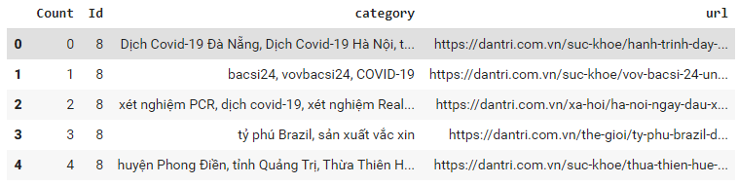
1. Overview Dataset
The datasets is collected by get tag from each news
The datasets is get from zing, baomoi, dantri news
The datasets contain:
+ Id ( The label of each category)
+ Category( The tags from each news)
+ URL of each news

Slide 8
PROCESS DATASETS
2. Evaluate Dataset

Slide 9

2. Evaluate Dataset
The datasets is label by the content writer of the paper. So It can be used as the keyword of each paper
We get datasets from our friend which is used for education purpose
The dataset is collected from trusted sources and on popular e-new in Viet Nam

Slide 10
ALGORITHMS
1. Word2Vec Model

Slide 11
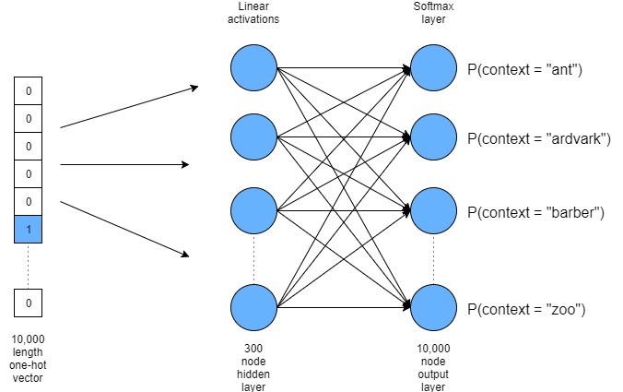
1. Word2Vec Model
- Word2vec is a technique for NLP.
- The word2vec algorithm uses a neural network model to learn word associations from a large corpus of text.

Slide 12
ALGORITHMS
2. KNN Model

Slide 13
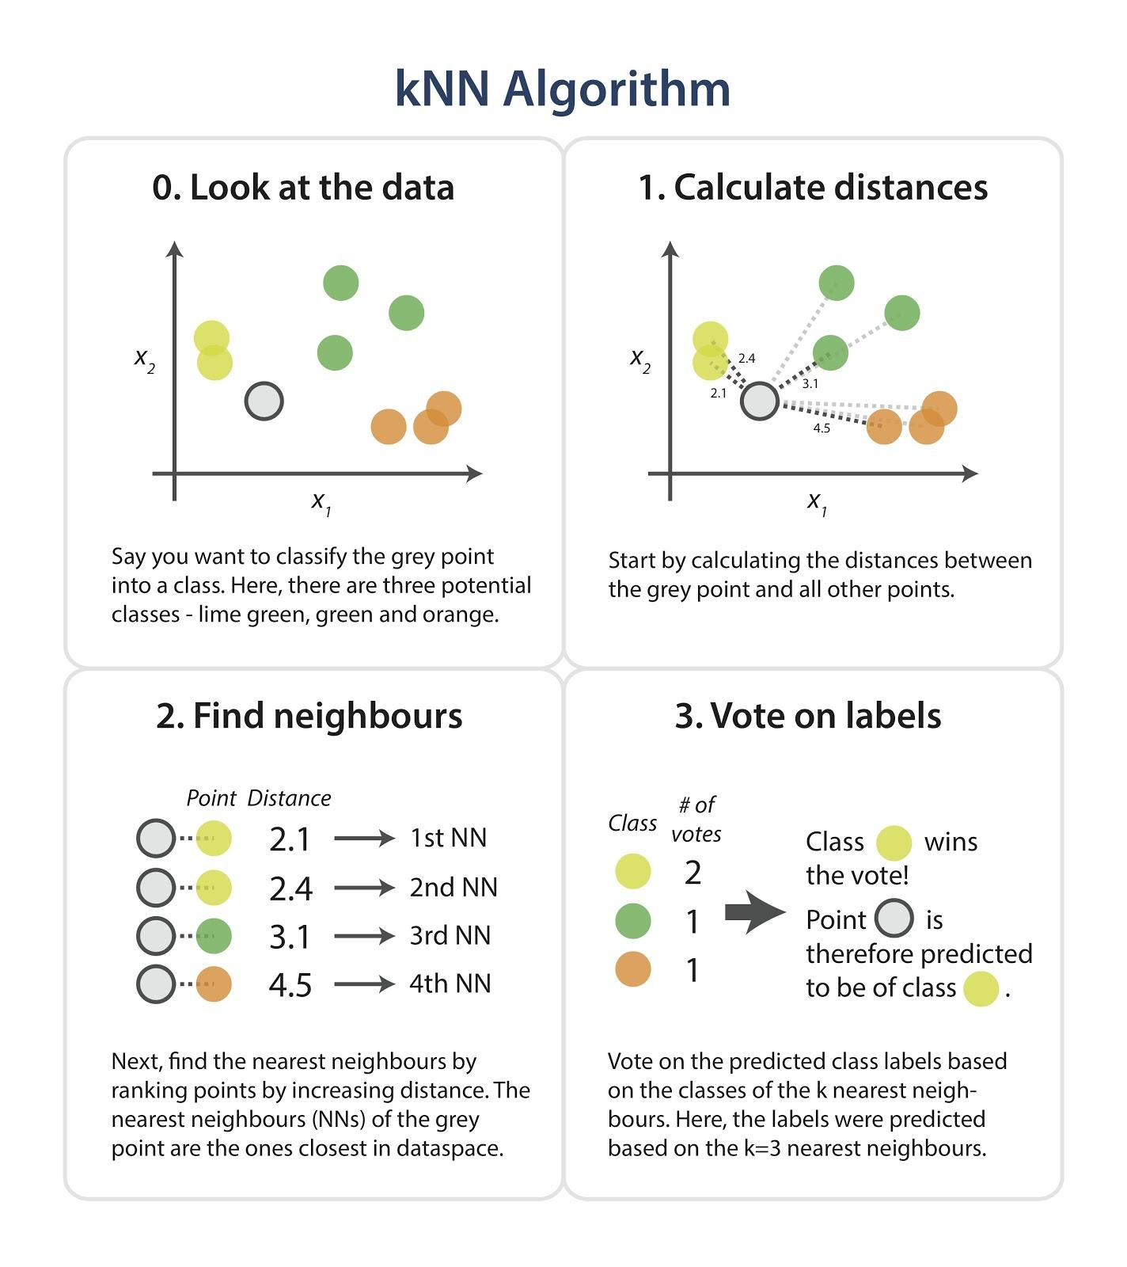
2. KNN Model
The k-nearest neighbors (KNN) algorithm is a simple, supervised machine learning algorithm that can be used to solve both classification and regression problems.
Easy to implement and understand,
Major drawback of becoming significantly slows as the size of that data in use grows.

Slide 14
ALGORITHMS
3. K-Means Model

Slide 15
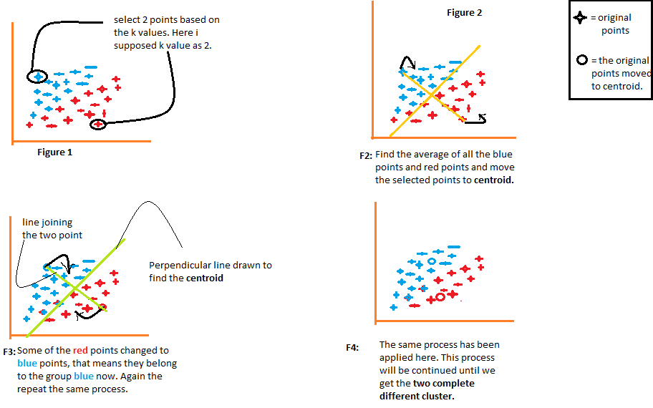
3. K-Means Model
K-means clustering is a method of vector quantization, originally from signal processing.
Partition n observations into k clusters in which each observation belongs to the cluster with the nearest mean(cluster centers or cluster centroid)

Slide 16
OUR WORK
1. Category Model

Slide 17
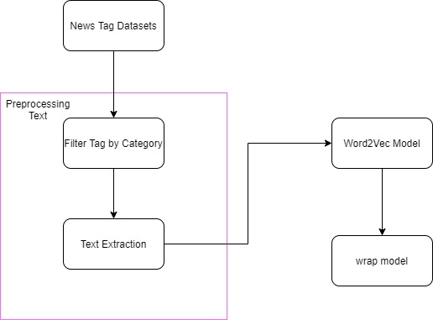
1. Category Model
Step 1: Filter tag by category
Step 2: remove stop words, clean text, match single word together
Step 3: Text extraction
Step 4: set hyper parameter ( learning rate, word size, alpha, min_count,…)
Step 5: Train word2vec model
Step 6: wrap model to object

Slide 18
OUR WORK
2. Word2vec visualization

Slide 19
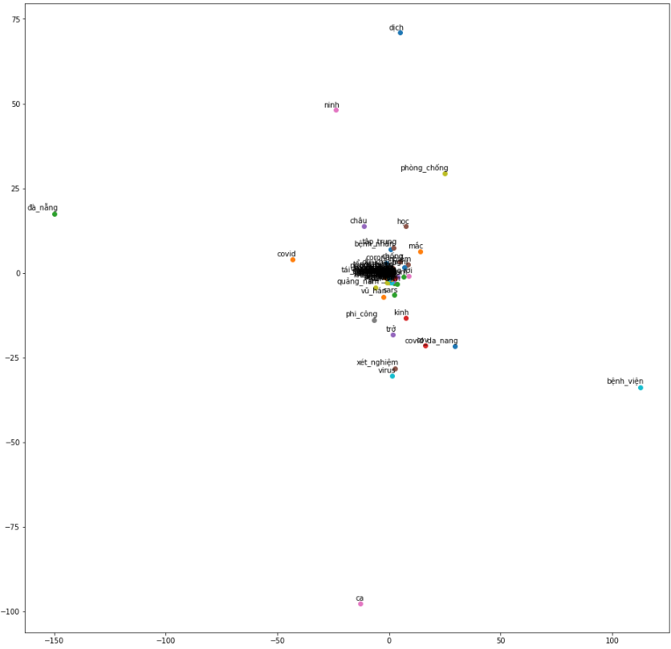
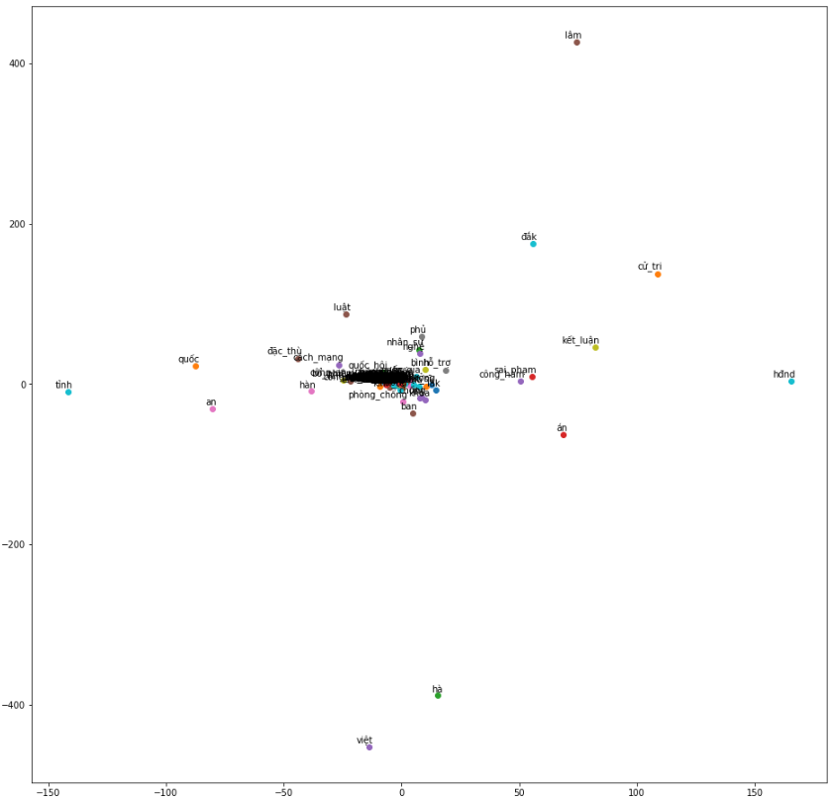
2. Word2vec visualization
Covid19 feature vector
Politic feature vector

Slide 20
OUR WORK
3. Summary news process

Slide 21
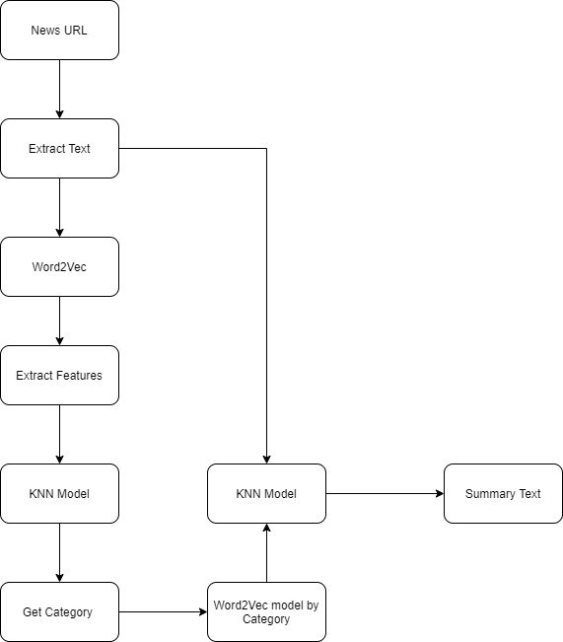
2. Summary news process
Step 1: Get text from news URL
Step 2: Convert text to vector by word2vec
Step 3: Train KNN model on multi category model with 6 classes
Step 4: get category of news from KNN model
Step 5: Apply news text and category model into K-means
Step 6: Get summary of text

Slide 22
DEMONSTATION
1. Our Result

Slide 23
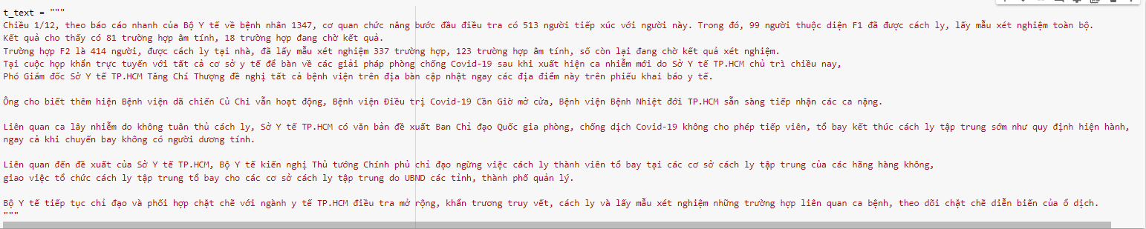
1. Our Result
Origin Text
Summary text

Slide 24
CONCLUSTION
We have successful solve the new summary problem
Our model can run in short time with good performance for machine learning approach
We gain more knowledge about word2vec, KNN, K-means
However, the result still not good in general. So we need to improve the algorithm.
In the future, We want to change the method to classification the category due to the overfit with KNN model
We will also improve the embedding word by using PhoBert instead of Word2vec.

